Slide 1
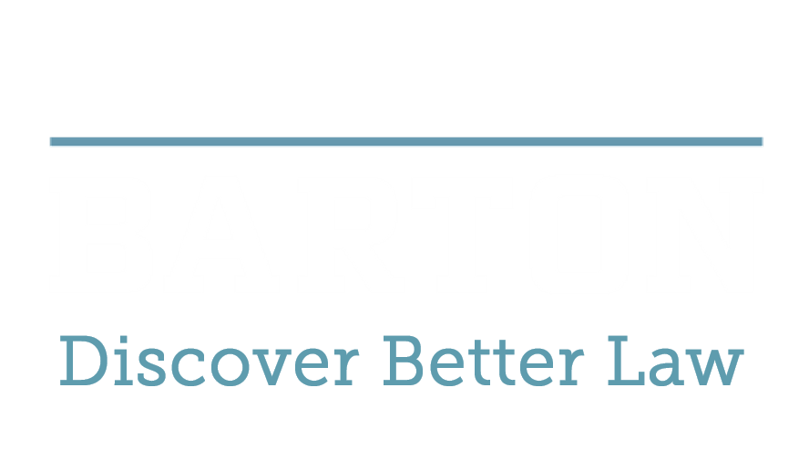

How Does the New NYS
Cybersecurity & Privacy Law
(SHIELD Act) Impact Your Business?
2.11.2020

Slide 2



Jim Moreo
Kenneth N. Rashbaum
Steven R. Ebert
Principal
Cornerstone.IT
646.530-8920
Jim.Moreo@Cornerstone.IT
Partner
Barton LLP
212.885.8836
Krashbaum@BartonEsq.com
Partner
Barton LLP
212.885-8329
Sebert@BartonEsq.com

Slide 3



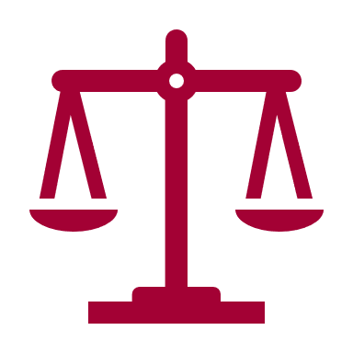
Agenda
The business imperative: outside counsel guidelines require privacy and cybersecurity safeguards. Data protection as a means to get and maintain clients.
The ethics imperative: cybersecurity and privacy awareness as a way to maintain client confidentiality of client information.
The practicality and implementation imperative: where to start, how to implement controls, how to train the work force, and how to stay aware of current and new threats
The compliance imperative: law firms are subject to the privacy and cybersecurity laws of a growing number of states.

Slide 4

New York SHIELD Act
Cybersecurity Program and Security Requirements (effective March 21, 2020)
Who is Covered? All who “own or license private information of a resident of New York,” except “small businesses:”
Under $3,000,000 in gross annual revenue;
Less than 50 employees; or
Under $5,000,000 in total year-end assets.
“Safe Harbor”(for Cybersecurity Program requirements only): If subject to and in compliance with:
HIPAA
New York Department of Financial Services Cybersecurity Regulations, 23 NYCRR Part 500
Data security regulations of, or statutes administered, by any federal or New York State agency, department or commission

Slide 5

New York SHIELD Act
What is covered: “Private Information”
Social Security Number
Driver’s License Number
Account, credit or debit card number if the number could be used to access an account without an additional security code, password, access code or additional identifying information
Biometric information (fingerprint, facial image, iris scan, etc.), used to authenticate identity
A user name or email address “in combination with a password or security question and answer that would permit access to an online account.”

Slide 6

New York SHIELD Act
How is the information to be protected: the Cybersecurity Program
An employee responsible for coordination of the security program
Risk assessments (internal and external)
Service provider due diligence for ability to meet these safeguards
Change management
Regular testing of key controls
Incident response plan
Malware defenses
Access controls
Data deletion schedule
Work force training

Slide 7

NYDFS Cybersecurity Regulations (23 NYCRR Part 500) and Law Firms
Client jurisdiction: Organizations licensed to do business under the NY Banking or Insurance Laws
More prescriptive than SHIELD Act
23 NYCRR 500.11: Covered clients are required to perform cybersecurity due diligence on their Third Party Service Providers (including law firms) and obtain written representations the providers have implemented:
Cybersecurity policies and procedures
Encryption of Nonpublic Information at rest and in motion
Access controls
Cybersecurity event notice to the Client
Multi-Factor Authentication

Slide 8

NY SHIELD Act Breach Notification: Key Changes From Preexisting Law
Amendments to GBL§ 899-aa
Unauthorized access to Private Information, not acquisition, triggers reporting obligations
Incident involving over 500 NY residents must be reported to state attorney general within 10 days “after determination.”
If disclosure was “inadvertent” and following criteria are met there is no need to report to government or individuals:
Disclosed by a person authorized to access Private Information (i.e., employee or contractor)
Disclosure is unlikely to result in “financial hard to the affected persons or emotional hard in the case of unknown disclosure of online credentials”

Slide 9






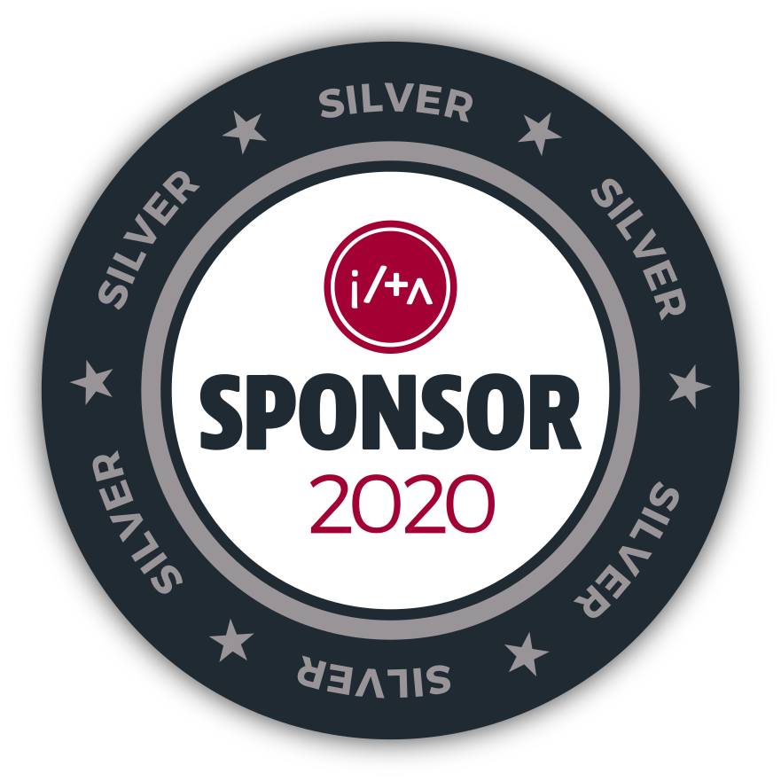
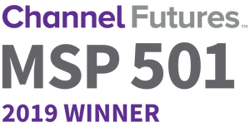




About Cornerstone.IT
Legal IT Focused
Experience
Understand IT
Best Practices
Data Migration
Managed
Services
A W A R D S

Slide 10



How Do You Reduce Cybersecurity Risk?
Basic
Prevention
Password Policy
Antivirus Software (Signature vs Machine Learning)
Multi-Factor Authentication
Security Patching
Web Proxy/End-Point Detection
Security Awareness Training

Slide 11
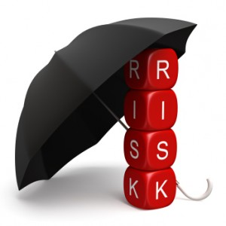


How Do You Reduce Cybersecurity Risk?
Advanced Prevention
Identify Personal Identifiable Information (PII)
Minimize File Shares
Document Management Systems
Data Loss Preventions
Application Whitelisting

Slide 12




How Do You Monitor for Malicious Activity?
Monitoring
Event Logs (Enable, Configure, Save)
Security Information & Event Management (SIEM)
Intrusion/Threat Detection
Vulnerability Scan
Third Party Security Operation Center

Slide 13


How Do You Prepare for Security Audits?
Compliance & Certifications
Security Assessment
National Institute of Standards (NIST-SP 800-53 Rev4 A)
Security Compliance - https://nvd.nist.gov/800-53/Rev4
International Organization for Standards 27000 (ISO) Certification

Slide 14


Have questions? Jim.Moreo@Cornerstone.IT 646.530-8920 Krashbaum@BartonEsq.com 212.885.8836

